Slide 1
Lecture 3
More into regression

Slide 2
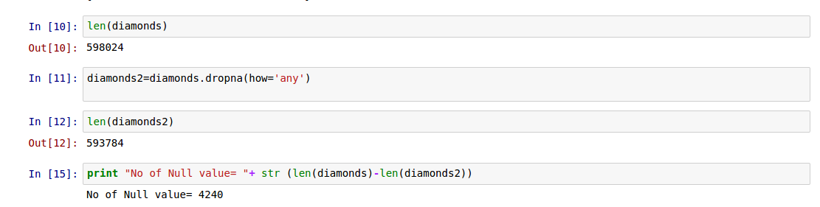
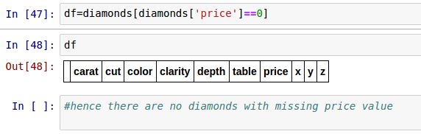
PREPARING DATA:
1.Check for null values.
2. Check for zero price values.

Slide 3
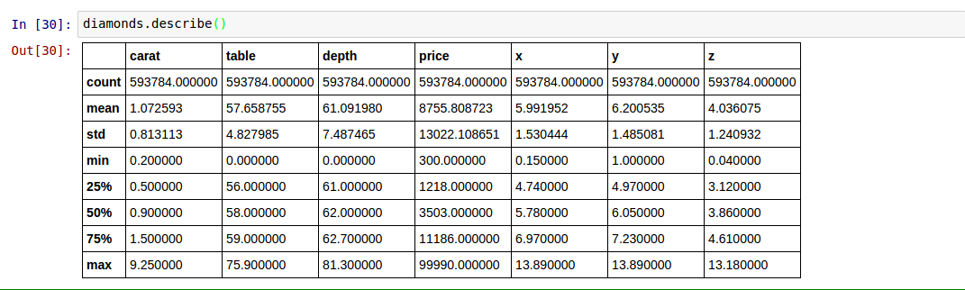
EVALUATION OF DATA:
New Statistical Information:

Slide 4
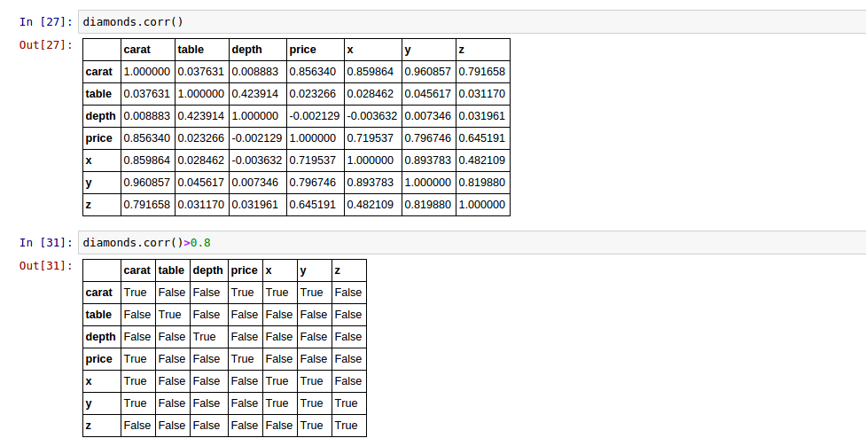
2. Correlations

Slide 5
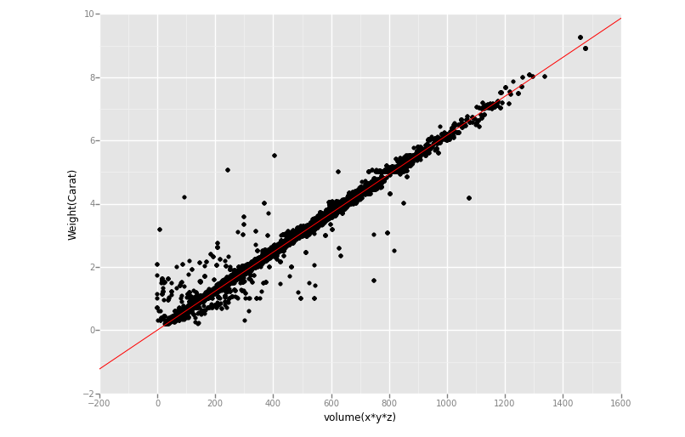
OUTPUT:
HOW IT WORKS:
ggplot is invoked.
A blank coordinate system with labeled axes is put up.
The points are plotted.
The axis redefined and cropped.
The line draw as another layer on top of the points.

Slide 6
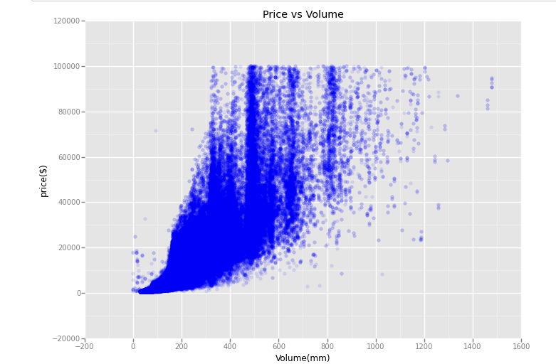
PRICE VS VOLUME
NOTE:
Geom-jitter
Over-plotting hides the number of points in each neighbourhood. We can reduce this problem by making the points more transparent.

Slide 7
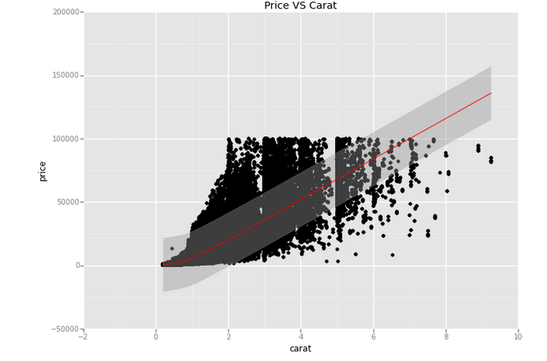
NOTE:
A quadratic line of regression signifies that value of price depends on the value of carat. But is only carat, let’s see closely.

Slide 8
Today
Multi-Linear Regression
Decision Boundary
Polynomial Regression
Logistic Regression

Slide 9
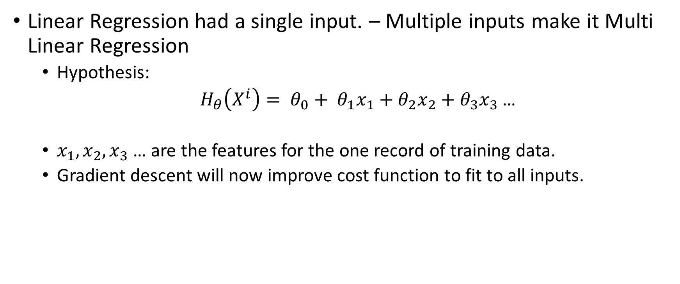
Other types – Multi Linear Regression

Slide 10
Multi-Linear Regression
How will you visualise this ?

Slide 11

Multi-Linear Regression
For two features :
Take each feature as an axis in your graph.

Slide 12
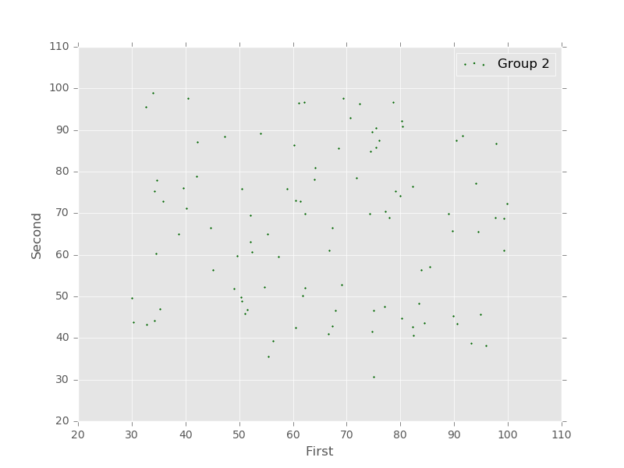
Multi-Linear Regression
For two features :
Take each feature as an axis in your graph.

Slide 13
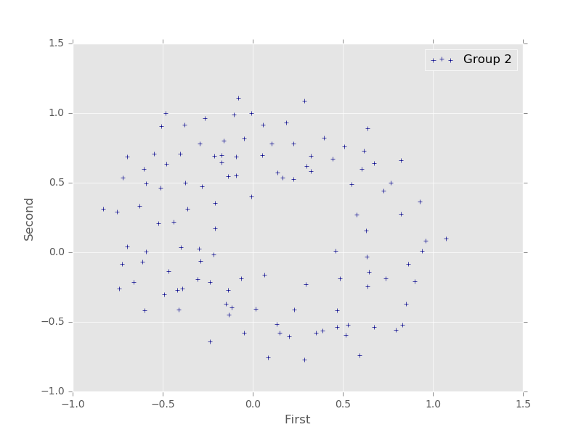
Multi-Linear Regression
For two features :
Take each feature as an axis in your graph.

Slide 14
Multi-Linear Regression
For two features :
Take each feature as an axis in your graph.
Sometimes also used for Classification.
How/when ?

Slide 15
Multi-Linear Regression
For two features :
Take each feature as an axis in your graph.
Sometimes also used for Classification.
How/when ? - When the outcome/result is discrete !

Slide 16
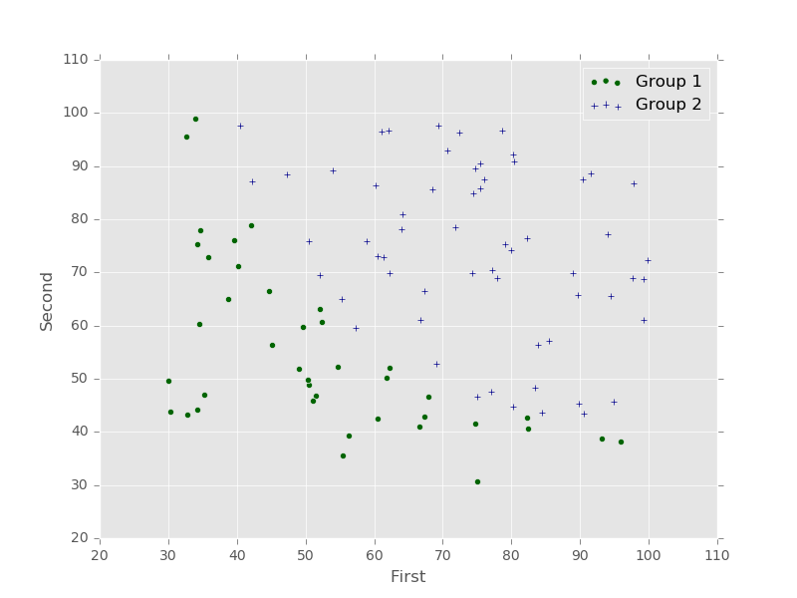
Multi-Linear Regression
For two features :
Take each feature as an axis in your graph.
Sometimes also used for Classification.
How/when ? - When the outcome/result is discrete !

Slide 17
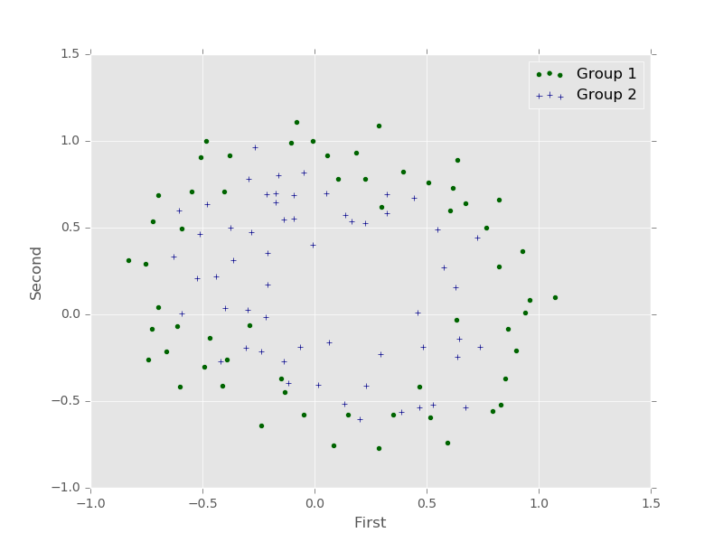
Multi-Linear Regression
For two features :
Take each feature as an axis in your graph.
Sometimes also used for Classification.
How/when ? - When the outcome/result is discrete !

Slide 18
Decision Boundary
Equation:

Slide 19
Decision Boundary
Equation:
How is it possible to get a decision boundary out of this equation ? HINT: think of how we visualised the graph!

Slide 20

Decision Boundary
Equation:
: Equate this to zero to get a line among x1, and x2 !
How is it possible to get a decision boundary out of this equation ? HINT: think of how we visualised the graph!

Slide 21
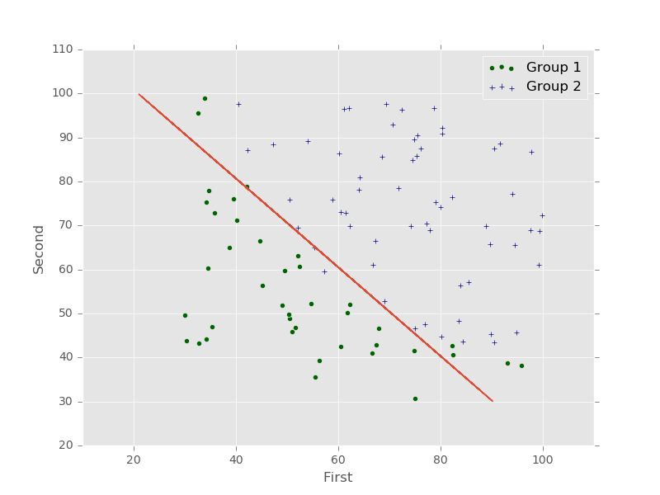

Slide 22
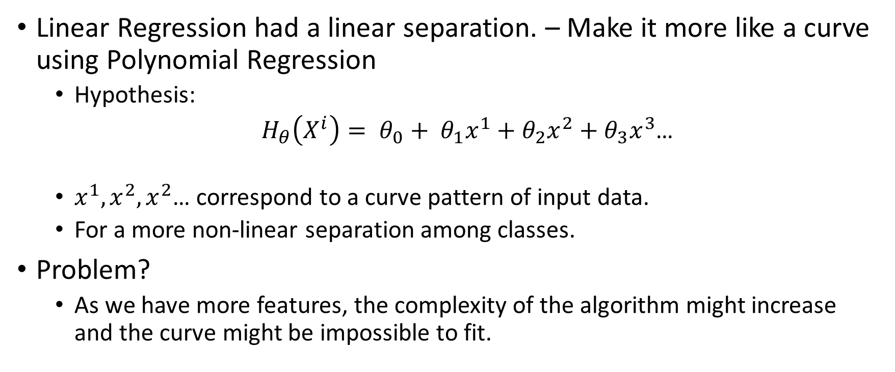
Other types – Polynomial Regression

Slide 23
Other types – Polynomial Regression
Problem ?

Slide 24
Other types – Polynomial Regression
Problem ?
What happens when x1 = 100, x2 = 100 and x3 = 100 ?

Slide 25
Other types – Polynomial Regression
Problem ?
Becomes harder to handle high order terms!
What happens when x1 = 100, x2 = 100 and x3 = 100 ?

Slide 26
Other types – Polynomial Regression
Problem ?
Becomes harder to handle high order terms!
What happens when x1 = 100, x2 = 100 and x3 = 100 ?
How about the curve ? Can you make the curve go circular ?

Slide 27
Other types – Polynomial Regression
Problem ?
Becomes harder to handle high order terms!
Curve cannot be made circular !
What happens when x1 = 100, x2 = 100 and x3 = 100 ?
How about the curve ? Can you make the curve go circular ?

Slide 28

Logistic Regression
Solves the problem in Polynomial Regression
Attempts to make the curve non-linear using a simple add-on function on the Linear Regression.
Sigmoid Function

Slide 29
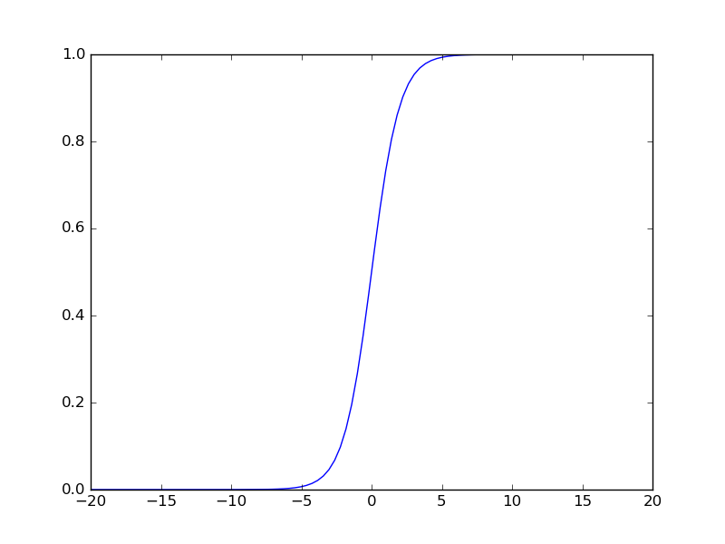
Sigmoid Function

Slide 30

Sigmoid Function

Slide 31
Sigmoid Function
What will be the maximum value of this the exp ? What will be the minimum ?

Slide 32
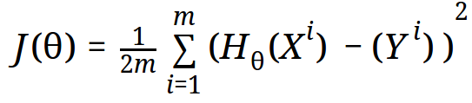
Cost
The previous cost function was ?

Slide 33
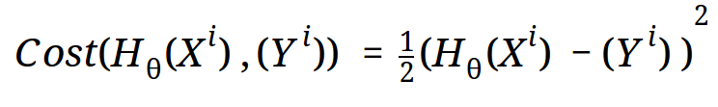
Cost
The previous cost function was ?

Slide 34
Cost
The previous cost function was ?
What will be the shape of the graph of this function ?

Slide 35
Cost
The previous cost function was ?

Slide 36
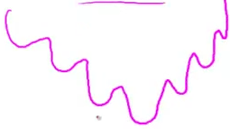
Cost
The previous cost function was ?
Non-Convex

Slide 37
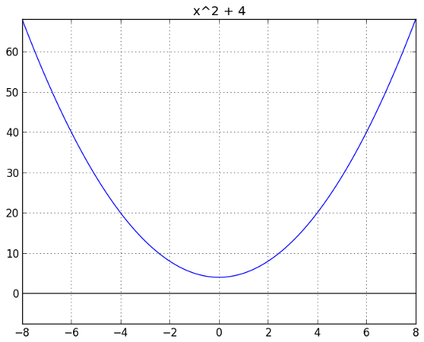
Cost
The previous cost function was ?
Non-Convex
Convex

Slide 38
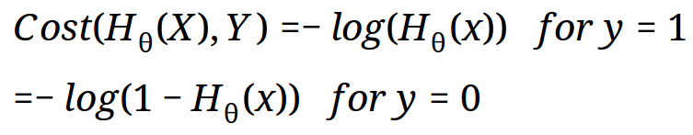

Slide 39
What difference does the log term make ?( HINT: Visualise the graphs of -log(z) and -log(1-z) )

Slide 40
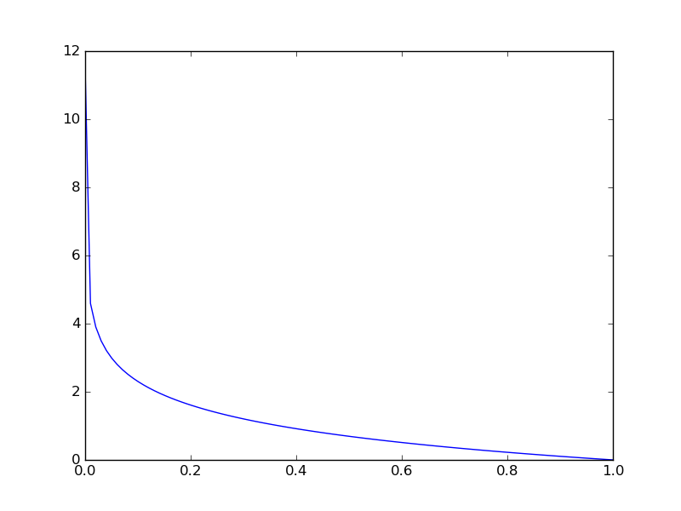
log (z)

Slide 41
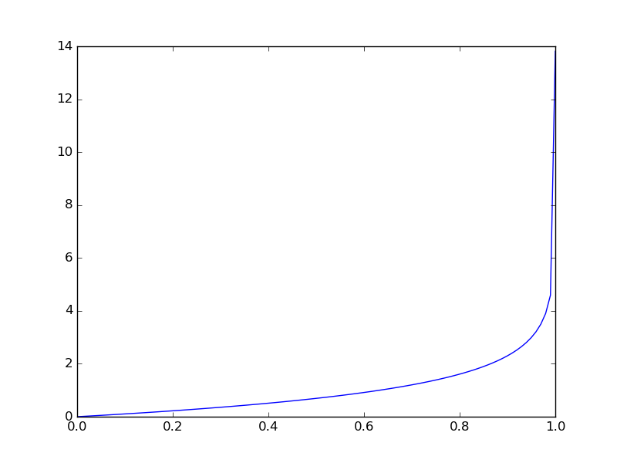
log (1 - z)

Slide 43
What will be the maximum value of this function ? What will be the minimum ?

Slide 44
What will be the value of cost when y = 1 and H(x) = 1 ?
when y = 1 and H(x) = 0 ?

Slide 46
Gradient Descent
Remains same

Slide 47
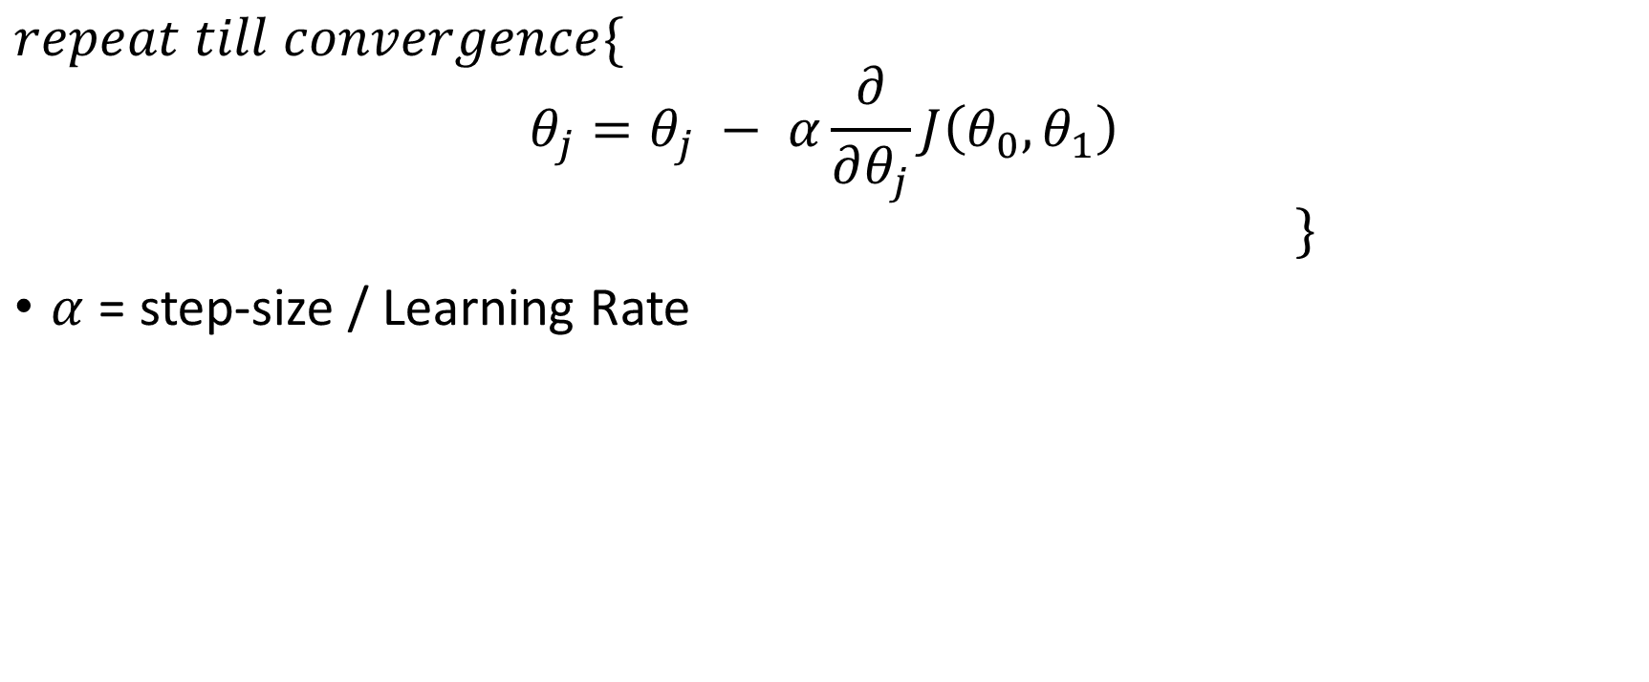
Gradient Descent

Slide 48
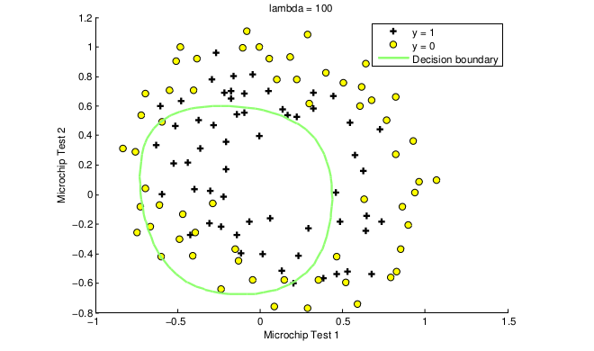
Problems with classification ?
Underfitting

Slide 49
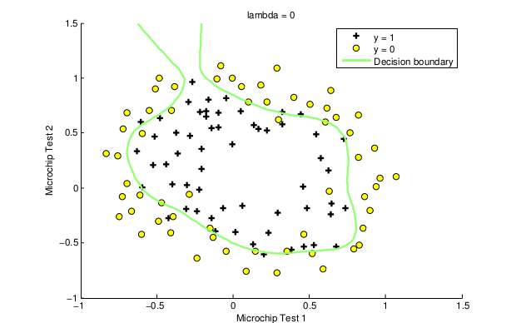
Problems with classification ?
Overfitting

Slide 50
Regularisation
Avoid those problems. How ?
Add a constant term to all gradient/costs. Why ?
x = [ 1, 1, 1, 1 ]
theta1 = [ 1, 0, 0, 0 ]
theta2 = [ 0.25, 0.25, 0.25, 0.25 ]
Both with x give same outputs, which one would you choose ? and Why ?

Slide 51
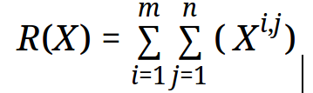
L1 Regularisation
Add this with your cost function and gradient descent.

Slide 52
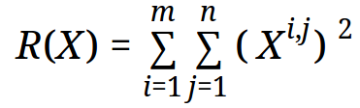
L2 Regularisation
Add this with your cost function and gradient descent.

Slide 53
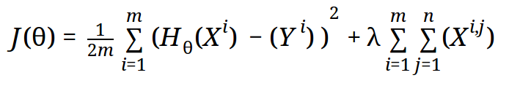
Cost Function Regularisation
Lambda ? - How much you want to add. Usually determines overfitting and underfitting. Handle with Care !

Slide 54
Summary
fit more than just a line for regression
Decision boundaries for classification
Sigmoid function for use in logistic regression
Logistic regression cost
Regularisation - Use L2 Regularisation

Slide 55
What Next ?
Bayes Theorem and Bayesian Networks
Decision Trees

